Slide 1
Memisahkan atribut berdasarkan class
No | Nilai | Tepat Waktu | Tidak Tepat Waktu | Total
1 | A | 0 | 79 | 79
2 | A- | 1 | 111 | 112
3 | B+ | 3 | 92 | 95
4 | B | 0 | 50 | 50
5 | B- | 0 | 59 | 59
... | ... | ... | ... | ...
Total |  | 4 | 532 | 536

Slide 2
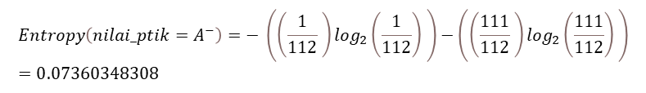

Menghitung nilai information gain
Menghitung entropy masing-masing atribut
$$Entropy\left(nilai_ptik=A^{−}\right)=− \left(\left(\frac{1}{112} \right)\log_{2}\left(\frac{1}{112}\right) \right)−\left(\left(\frac{111}{112} \right)\log_{2}\left(\frac{111}{112}\right) \right)=0.07360348308$$
$$Entropy\left(D\right)= −\sum_{k=1}^{I}{{Pk}^{\log_{2}}Pk}$$
Keterangan :
D : Himpunan kasus
I : Jumlah Partisi D
Pk : Proporsi terhadap D
No | Nilai | Tepat Waktu | Tidak Tepat Waktu | Total | Entropy
1 | A | 0 | 79 | 79 | 0
2 | A- | 1 | 111 | 112 | 0.07360348308
3 | B+ | 3 | 92 | 95 | 0.20224942454
4 | B | 0 | 50 | 50 | 0
5 | B- | 0 | 59 | 59 | 0
... | ... | ... | ... | ... | ...
Total |  | 4 | 532 | 536 | 0,063458116

Slide 3
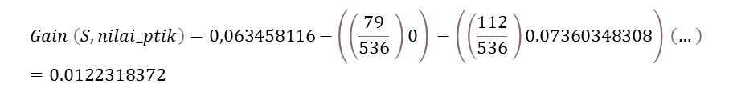
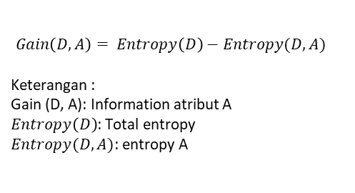
Menghitung Nilai Information Gain
$Gain\left(D, A\right)= Entropy\left(D\right)−Entropy(D, A)$
Keterangan :
Gain (D, A): Information atribut A
$Entropy\left(D\right)$: Total entropy
$Entropy(D, A)$: entropy A
$$Gain \left(S, nilai_ptik\right)=0,063458116−\left(\left(\frac{79}{536} \right)0\right) −\left(\left(\frac{112}{536} \right)0.07360348308\right) \left(… \right)=0.0122318372$$
No | Nilai | Tepat Waktu | Tidak Tepat Waktu | Total | Entropy
1 | A | 0 | 79 | 79 | 0
2 | A- | 1 | 111 | 112 | 0.07360348308
3 | B+ | 3 | 92 | 95 | 0.20224942454
4 | B | 0 | 50 | 50 | 0
5 | B- | 0 | 59 | 59 | 0
... | ... | ... | ... | ... | ...
Total |  | 4 | 532 | 536 | 0,063458116
Information Gain
0.0122318372

Slide 4
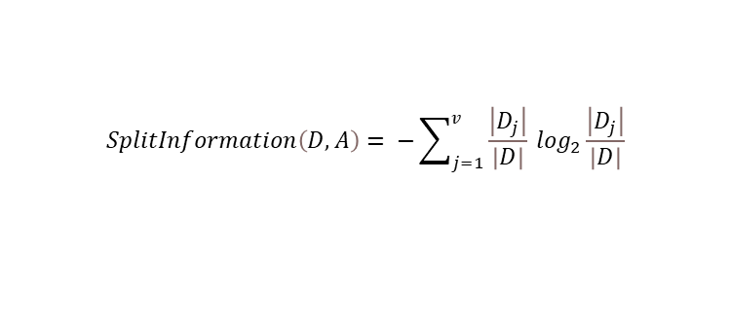
Menghitung Split Information
$$SplitInformation\left(D, A\right)= −\sum_{j=1}^{v}{\frac{\left|D_{j}\right|}{\left|D\right|}} \log_{2}\frac{\left|D_{j}\right|}{\left|D\right|}$$
Keterangan:
A : Atribut
v : jumlah partisi atribut A
|Dj| : jumlah kasus pada partisi ke j
|D| : jumlah kasus dalam D
$Split Information\left(nilai_ptik= A\right)=− \left(\left(\frac{79}{536} \right)\log_{2}\left(\frac{79}{536}\right) \right)=$0,407131
No | Nilai | Total | Split Information
1 | A | 79 | 0,407131
2 | A- | 112 | 0,471974
3 | B+ | 95 | 0,442429
4 | B | 50 | 0,319238
5 | B- | 59 | 0,350417
... | ... | ...
Total |  | 536 | 2,988596

Slide 5

Menghitung Nilai Gain Ratio
$$Gain Ratio \left(D, A\right)= \frac{InGain(D, A)}{SplitInformation(D, A)}$$
$$Gain Ratio\left(S, nilai_ptik\right)=\frac{0.0122318372}{2,988596}= 0.0040928373$$
No | Nilai | Total | Information Gain | Split Information | Gain Ratio
1 | A | 79 | 0.0122318372 | 0,407131 | 0.0040928373
2 | A- | 112 |  | 0,471974
3 | B+ | 95 |  | 0,442429
4 | B | 50 |  | 0,319238
5 | B- | 59 |  | 0,350417
... | ... | ...
Total |  | 536 |  | 2,988596

Slide 6
Urutan nilai atribut
No | Atribut | Gain Ratio
1 | Nilai_ta | 0.0193963349980881
2 | nilai_rpl | 0.006342041713679292
3 | nilai_ki | 0.0060591465187661364
4 | nilai_sbd | 0.005858881725153284
5 | nilai_kb | 0.0047987961523986225
6 | nilai_arkom | 0.0042807300148205345
7 | nilai_ptik | 0.004092837800870067
8 | nilai_daspro | 0.0040413831434278034
9 | nilai_tbo | 0.004012197680880066
10 | nilai_basdat | 0.003952735860485856
11 | nilai_pb | 0.0039007878033924218
12 | nilai_sisdig | 0.003870435545387093
13 | nilai_jarkom | 0.0036691589149483706
14 | nilai_so | 0.003629069701035852
15 | nilai_mpti | 0.0035302685109745847
16 | nilai_si | 0.0034285921427553547
17 | nilai_kp | 0.003245322787515182
18 | nilai_ecs | 0.003136420039747019
19 | nilai_alpro | 0.0029524749453053957
20 | nilai_metnum | 0.0029508498759991844
21 | nilai_strukdat | 0.0027789449714819437
22 | nilai_matdis | 0.0017482401613619324

